Slide 1
Database System
CL 203
Lab 02
Functions, Dates And Operators

Slide 2
ORACLE BUILT-IN FUNCTIONS
Functions are a very powerful feature of SQL and can be used to do the following:
Perform calculations on data
Modify individual data items
Manipulate output for groups of rows
Format dates and numbers for display
Convert column data types

Slide 3
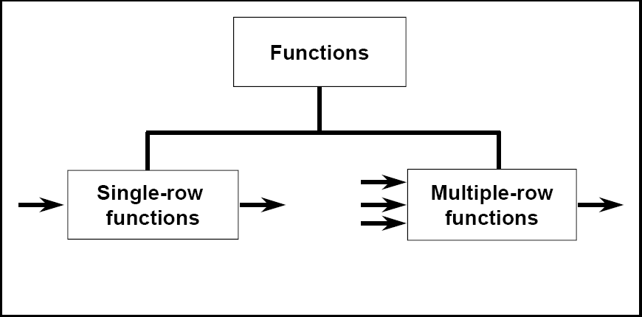
Types of Functions
Single-row functions
Multiple-row functions/Group Functions/Aggregate Functions

Slide 4
Types of Single Row Functions
1) Numeric Functions
These are functions that accept numeric input and return numeric values.
2) Character or Text Functions
These are functions that accept character input and can return both character and number values.
3) Date Functions
These are functions that take values that are of datatype DATE as input and return values of datatype DATE, except for the MONTHS_BETWEEN function, which returns a number.
4) Conversion Functions
These are functions that help us to convert a value in one form to another form. For Example: a null value into an actual value, or a value from one datatype to another datatype like NVL, TO_CHAR, TO_NUMBER, TO_DATE etc.

Slide 5
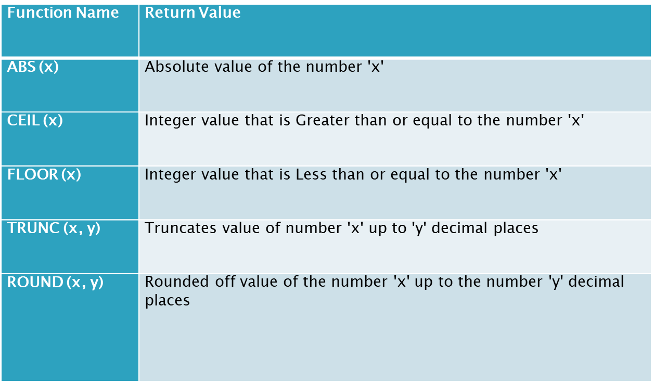
Numeric Functions

Slide 6
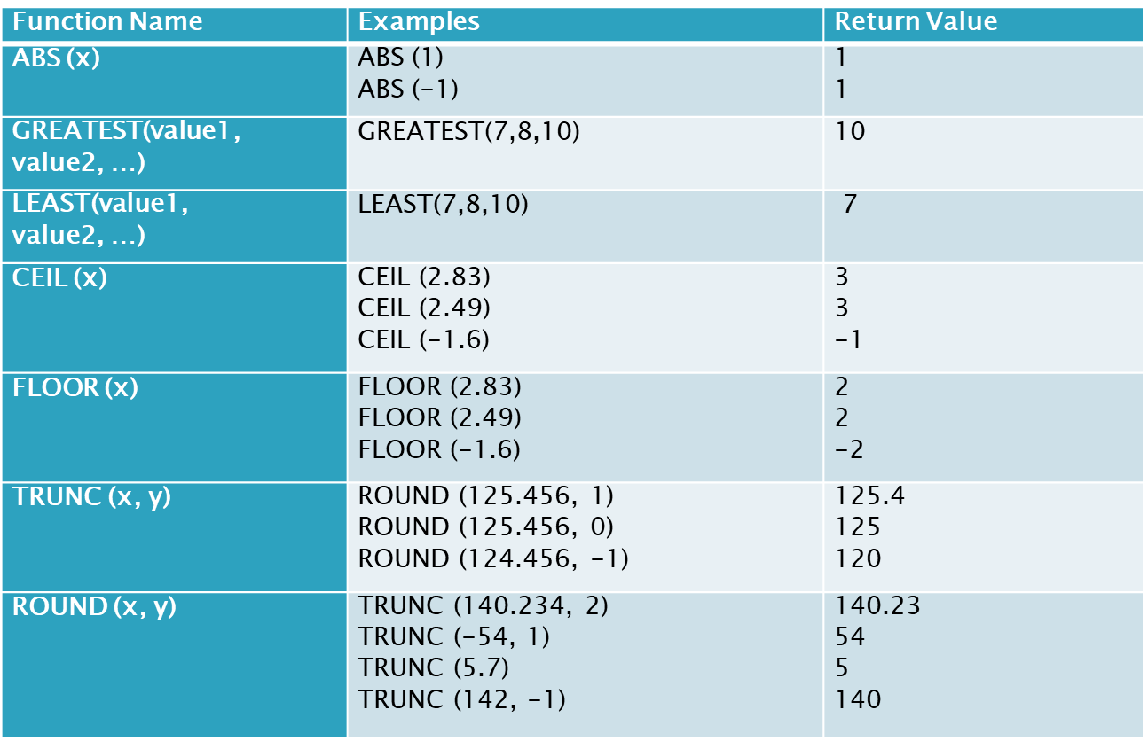
Numeric Functions Example

Slide 7
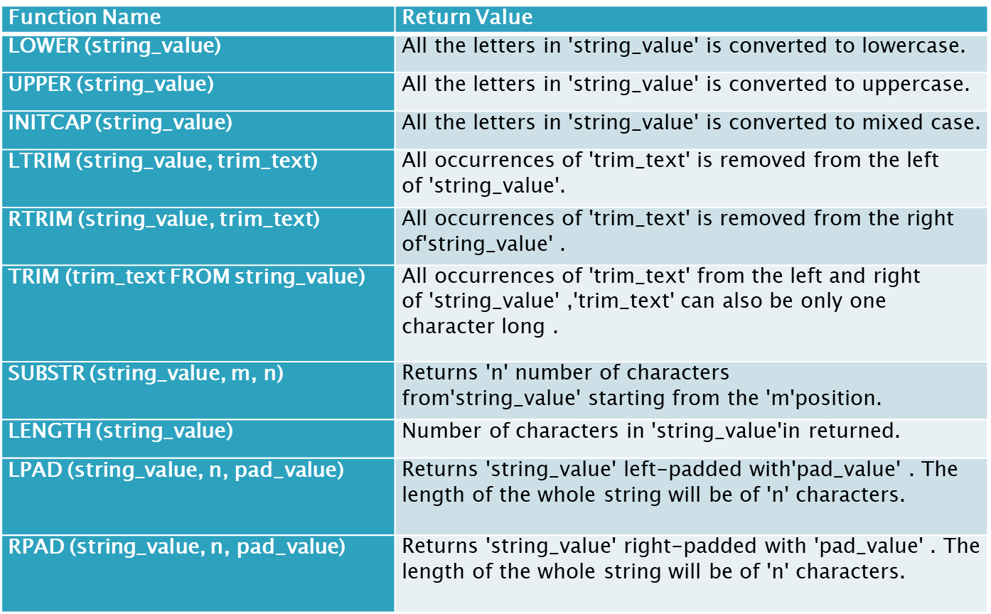
Character Functions

Slide 8
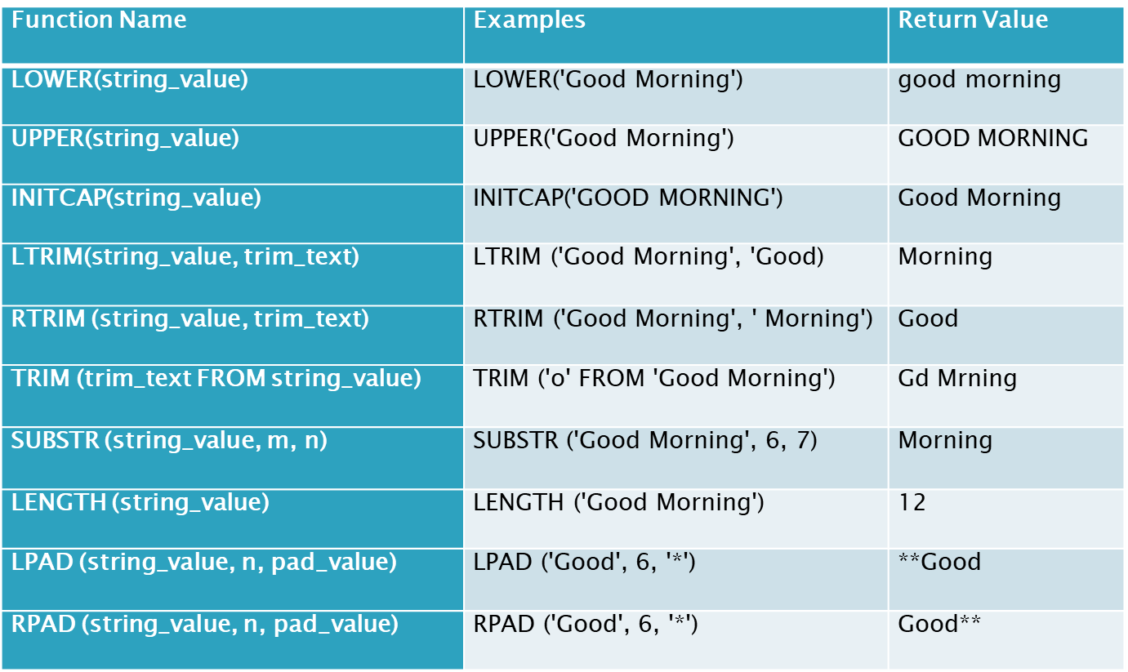
Character Functions Example

Slide 9
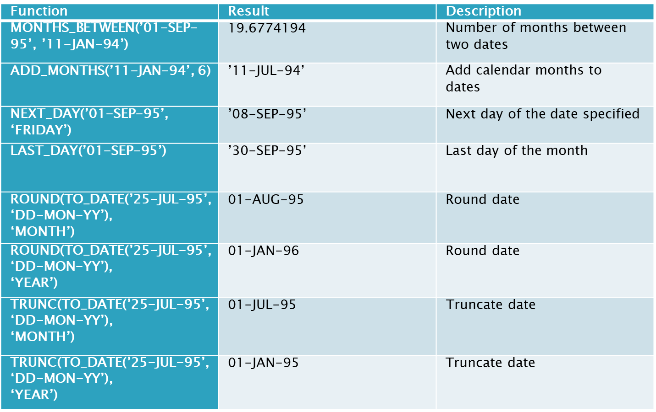
Date Functions

Slide 10
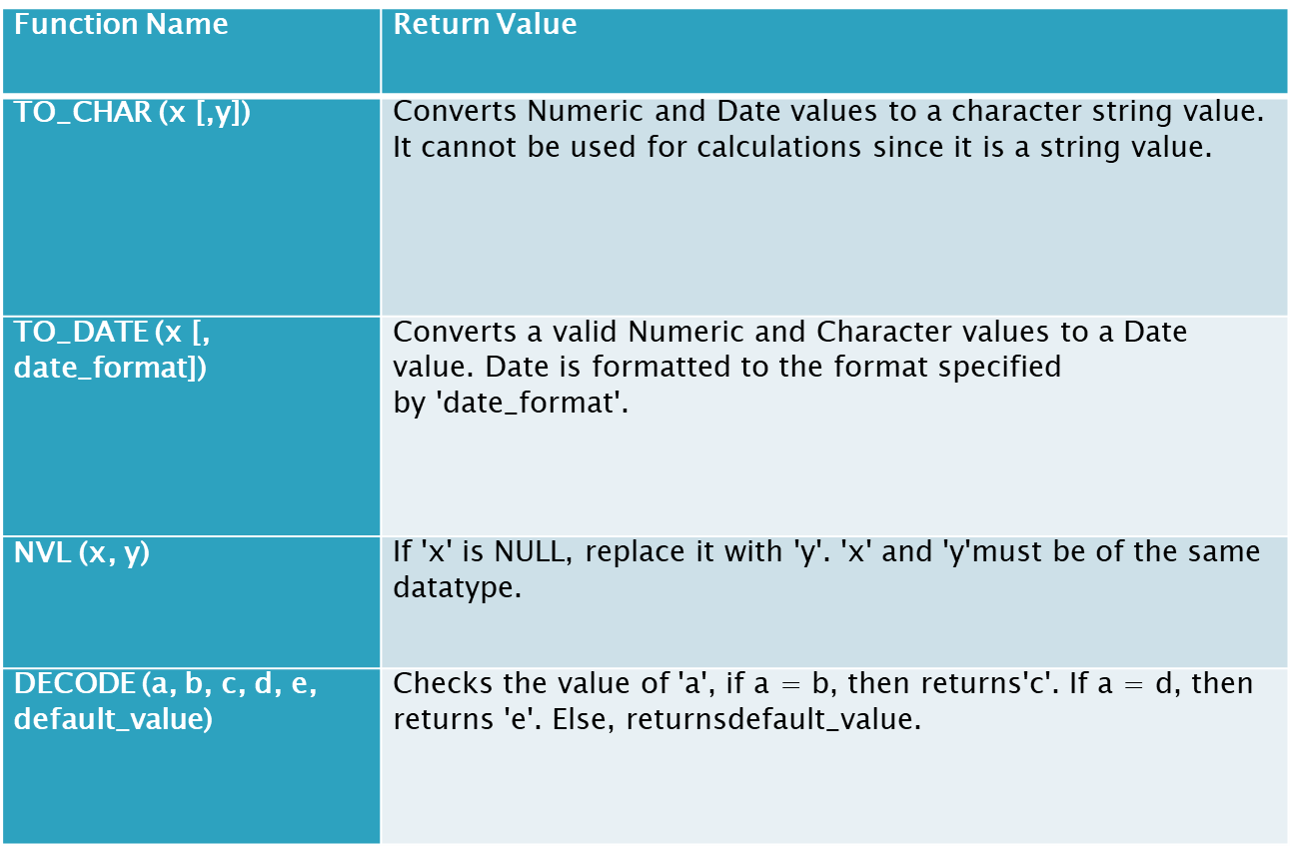
Conversion Functions

Slide 11
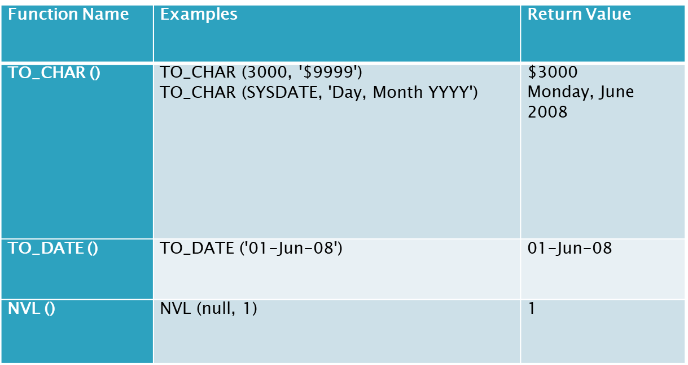
Conversion Functions Example

Slide 12
Count Operator
To count No of Rows in a Table using COUNT()
SELECT COUNT(*) FROM EMP;

Slide 13
Arithmetic Operators
Simple Computation:
SELECT 2*6 FROM dual;
Dual: Dummy Table
Date Arithmetic:
Select TO_DATE (’31-jul-2012’) + 2 FROM DUAL;
Select TO_DATE (’02-AUG-2012’) – TO_DATE (’31-JUL-2012’) FROM dual;
To_Date: A function that converts string into date

Slide 14
Operator Precedence
Select 10 * 12 / 3 – 1 FROM DUAL;
Result will be?
Now Applying parenthesis:
SELECT 10 * ( 12 / 3 -1) FROM DUAL;
Result ?

Slide 15
Using Column aliases
Optional Keyword: AS
Requires: “” (Double Quotations)
Syntax:
Select column_name1 AS Column_Alias1, Column_name2 Column_Alias2 FROM TABLE_NAME;

Slide 16
Distinct Keyword
Used to refrain from duplicate rows/records
SELECT DISTINCT COLUMN_NAME FROM TABLE_NAME
Show names of all jobs in a department.
SELECT DISTINCT JOB FROM EMP ;
Display no of jobs in a department
SELECT COUNT(DISTINCT JOB) FROM EMP

Slide 17
Comparison Operators
Operator | Description
= | Equal
<> or != | Not Equal
< | Less than
> | Greater than
<= | Less than or equal to
>= | Greater than or Equal to
ANY | Compares one value with any value in a list
ALL | Compares one value with all values in a list

Slide 18
Comparison Operators (Continued..)
Select Employees whose department number is not equal to 10:
SELECT * FROM emp WHERE deptno <> 10;
Select Employees whose dept no is > 10 or 20:
SELECT * FROM emp WHERE deptno> ANY (10,20);
In simple words, we can write this query as:
Select * from dept where deptno > 10 OR deptno > 20
Select all employees who have dept no > 10 and 20
Select * FROM dept WHERE deptno > All (10,20);
This query is equivalent to:
Select * from department where deptno > 10 AND deptno > 20

Slide 19
Conditions in SQL
Like Operator: Used in pattern matching
Underscore Character (_) Matches one character in a specific position
Percent Character (%) Matches any number of characters beginning at the specified position
Syntax:
SELECT column_name(s) FROM table_name WHERE column_name LIKE pattern

Slide 20
Like Operator (Continued..)
List the employee names starting with ‘K’ and ending with ‘S’.
SELECT ENAME FROM EMP WHERE ENAME LIKE ’K%S’
List the employees whose names having a character set ‘ll’ together.
SELECT * FROM EMP WHERE ENAME LIKE ‘%LL%’;
Similarly, use NOT LIKE keyword to reverse the rows retrieved by previous query.
List the employees whose Employee number not starting with digit78.
SELECT * FROM EMP WHERE EMPNO NOT LIKE ‘78%’;

Slide 21
Rownum Operator
Used to display certain number of rows
SELECT column_name(s) FROM table_name WHERE ROWNUM <= number
SELECT EMPNO, ENAME, DEPTNO FROM EMP WHERE ROWNUM <= 3;

Slide 22
IN Operator
It is used to select only those rows whose column value is in a list that you specify.
Syntax:
SELECT column_name(s) FROM table_name WHERE column_name IN (value1,value2,...)
List the employees who are working for the Department number 10 or20.
SELECT * FROM EMP WHERE DEPTNO IN (10,20);
Similarly, use NOT IN keyword for the reverse of this query Output
List all the emps except ‘PRESIDENT’ & ‘MGR”
Select * FROM EMP WHERE JOB NOT IN (‘PRESIDENT’,’MANAGER’);

Slide 23
Between Operator
Selects a range of data between two values
Syntax:
SELECT column_name(s) FROM table_name WHERE column_name BETWEEN value1 AND value2
List the emps Who Annual sal ranging from 30000 and 50000.
SELECT * FROM EMP WHERE SAL*12 BETWEEN 30000 AND 50000;

Slide 24
Order By Clause
To sort the retrieved rows based on a column value
SELECT * FROM Table_name ORDER BY Column_name(s)
List the employees who joined on 1-MAY-81,3-DEC-81,17-DEC-81,19-JAN-80 in asc order of seniority.
SELECT * FROM EMP WHERE TO_CHAR(HIREDATE,’DD-MON-YY’) IN (‘1-MAY-81’,’3-DEC-81’’17-DEC-81’’19-JAN-80’) ORDER BY HIREDATE;

Slide 25
Order By (Continued…)
Similarly, We can sort data in Ascending and Descending Order
SELECT * FROM EMP ORDER BY ENAME [Order];
[Order]
Asc: for ascending order
Desc: for descending order
The default is Asc
Display all the unique job groups in the descending order?
SELECT DISTINCT JOB FROM EMP ORDER BY JOB DESC;

Slide 26
Conversion Of NULL values
SELECT ename,NVL(comm,0),NVL2(comm,sal+comm,sal)as Income FROM emp;
NVL converts a NULL value to an actual value in this e.g to zero
NVL2: if commission is not null then return salary + commission else if commission is Null then return salary

Slide 27
Exercise
Print an employee name(first letter capital) and job title (lower Case).
Display the employee number, name (IN UPPER CASE) and department number for employee Blake.
Comparing the hire dates for all employees who started in 1982, display the employee number, hiredate, and month started using the ROUND and TRUNC functions.
To display the employee number, the month number and year of hiring.
List ANNUAL salary of all employees along with their names and job type.
List the employees in the ascending order of their salaries.
Display the salary of employee SCOTT with $ sign preceded.
List the employees information whose daily salary is more than Rs.100.
Display the employee number, name, salary, salary increase by 15% expressed as a whole number (labeled as New Salary), the difference between old salary and new salary (labeled as Increment).
Write a query that displays the employee name and commission amounts. If an employee doesn’t earn commission, put “No commission”.
Display each employee name, hiredate, and the day of the week on which the employee started, Label the column day.
Display the employee’s name (labeled name) with the first letter capitalized and all other letters lowercase and the length of their name (labeled length), for all employees whose name starts with J, A or M
Display the name of the employee who are working in the company for the past 35 years.
Display the total salary being paid to all employees.

